Slide 1



FUNDAMENTALS OF AI AND KNOWLEDGE REPRESENTATION
NAO CHALLENGE – 2021
Misbah Ghalib (01057540)
Rooshan Saleem Butt (01026467)
ALPHA
TEAM

Slide 2


NAO CHALLENGE – 2021
AIMA Python Library
Strategy
A* Search Algorithm
The cost of each move is the duration of each move. Heuristic is the remaining duration.

Slide 3
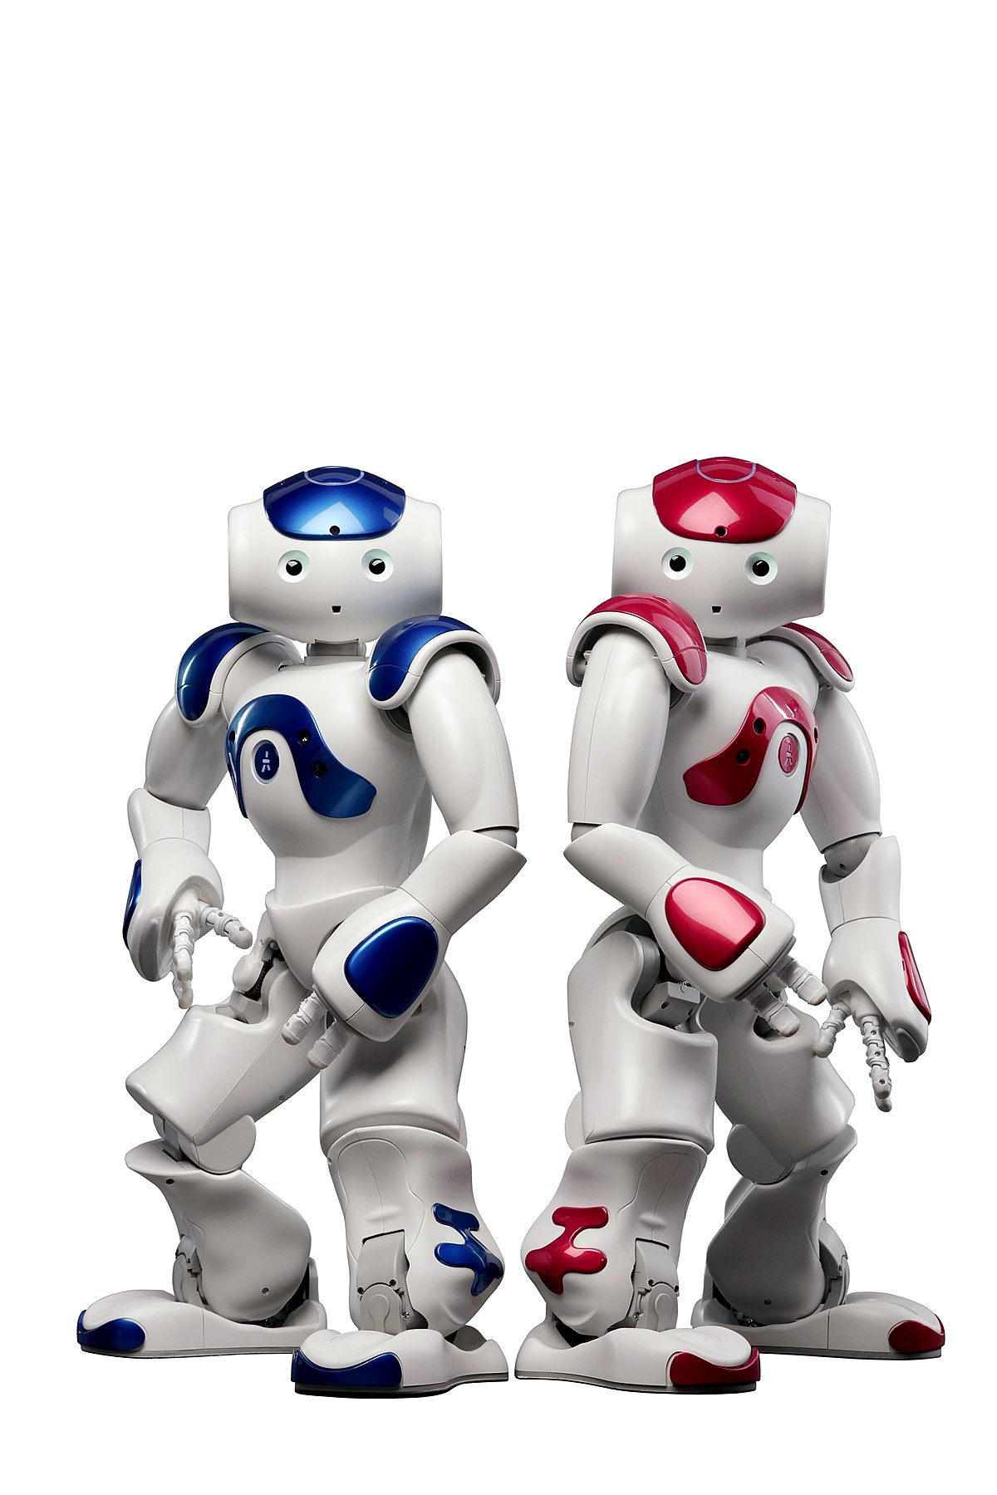
PLANNING AS A TREE SEARCH
A* search algorithm (with the AIMA library) in the space of possible choreographies
Starting from a single-move choreography, we try to ﬁnd a valid sequence of moves between two mandatory positions
The solution must respect some constraints

Slide 4
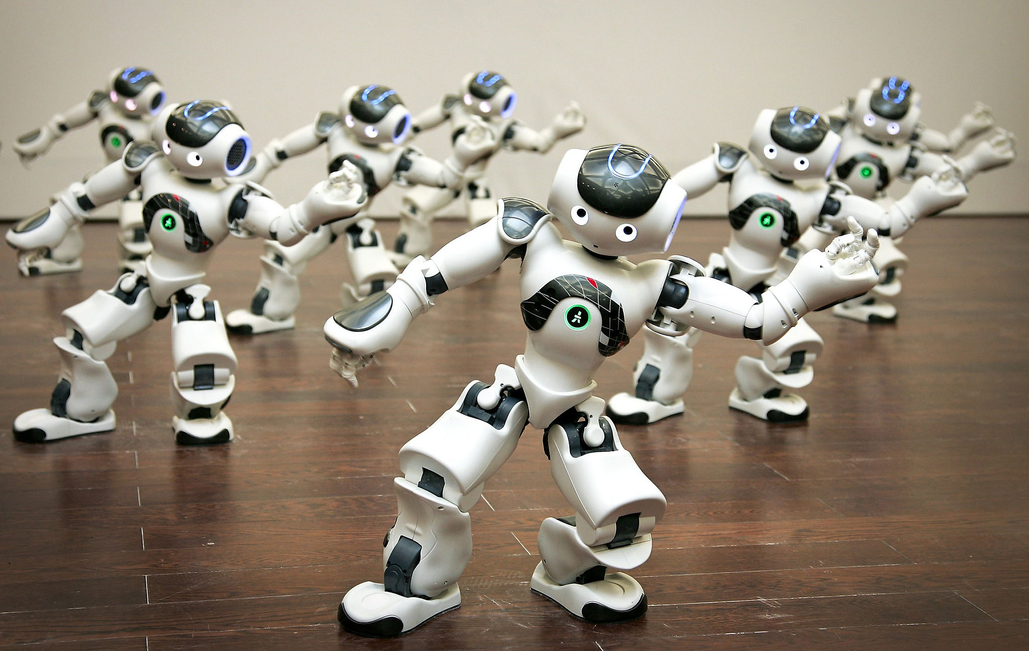
CONSTRAINTS
Time Constraint
Maximum Time: 180 seconds
Time of each partial solution depends upon both the number of sub-choreographies and the time required by mandatory positions
Mandatory Moves
The moves solution must contain all the mandatory moves specified in the problem statement

Slide 5
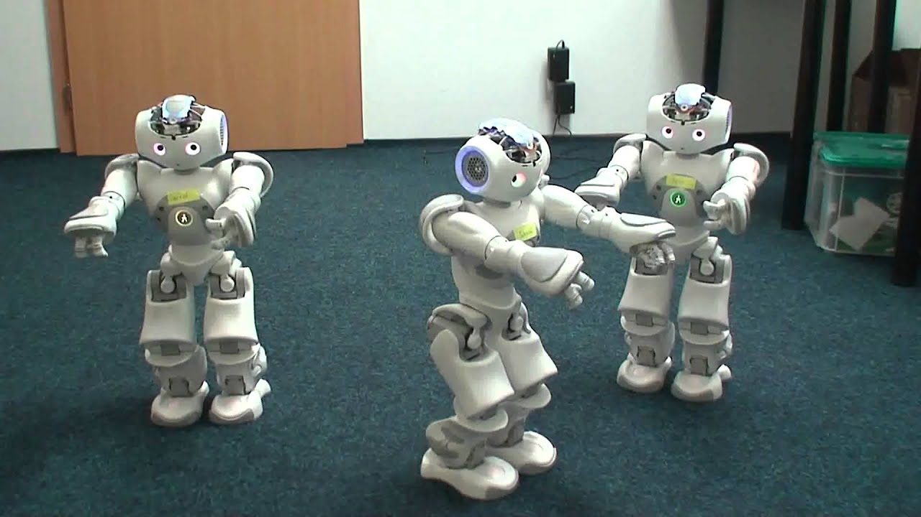
MOVES EXAMPLES
Clap
Dab
AirGuitar
Rhythm
(4.01 sec)
(3.09 sec)
(5.28 sec)
(2.93 sec)
Bow
Glory
Joy
Comeon
(4.60 sec)
(3.23 sec)
(4.55 sec)
(4.58 sec)

Slide 6
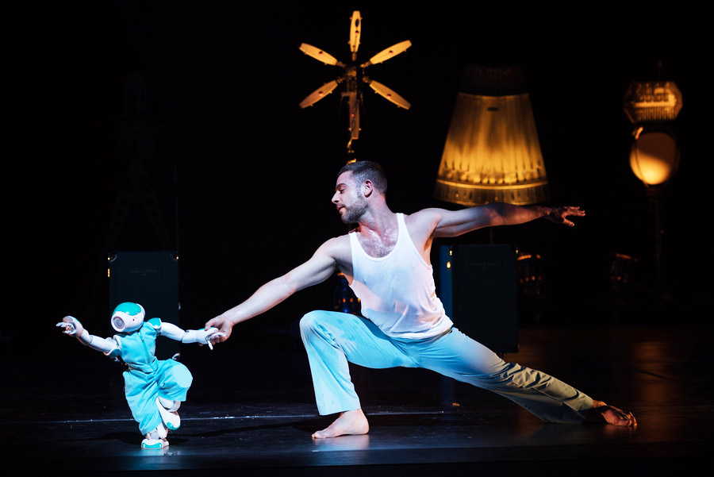
DEMO

Slide 7

